Slide 1
Module 3
Asymmetric Encryption Algorithm and Key Exchange
Topic:
Key distribution and Key exchange protocols:
Diffie-Hellman Key Exchange,
Man-in-the-Middle Attack

Slide 2
Key distribution and Key exchange protocols:
Diffie-Hellman Key Exchange
First public-key type scheme proposed.
Astounding concept that two parties can carry on a public conversation, and still end up with a secret that only the two of them know!
Public secret sharing.
Shared secret is derived from private secrets and publically shared information.
Notes:
2
This chapter continues our overview of public-key cryptography systems (PKCSs), and begins with a description of one of the earliest and simplest PKCS, Diffie-Hellman key exchange. This first published public-key algorithm appeared in the seminal paper by Diffie and Hellman that defined public-key cryptography [DIFF76b] and is generally referred to as Diffie-Hellman key exchange. The concept had been previously described in a classified report in 1970 by Williamson (UK CESG) - and subsequently declassified in 1987, see [ELLI99]. The purpose of the algorithm is to enable two users to securely exchange a key that can then be used for subsequent encryption of messages. The algorithm itself is limited to the exchange of secret values. A number of commercial products employ this key exchange technique.

Slide 3
The Diffie–Hellman algorithm depends for its effectiveness
on the difficulty of computing discrete logarithms.
“a” primitive root of a prime number p is one whose powers
modulo p generate all the integers from 1 to p - 1.
That is, if a is a primitive root of the prime number p, then the
numbers a mod p, a² mod p, ......, a^{p-1} mod p
are distinct and consist of the integers from 1 through p - 1 in
some permutation.
For any integer b and primitive root a of prime number p,
we can find a unique exponent i such that
b ≡ a^{i} (mod p) where 0 ≤ i ≤ (p - 1).
The exponent i is referred to as the discrete logarithm of b for the
base a, mod p.
We express this value as dlog_{a,p}(b).

Slide 4
Diffie-Hellman Key Exchange
A public-key distribution scheme:
Cannot be used to exchange an arbitrary message.
Rather it can establish a common key known only to the two participants.
Value of key depends on the participants (and their private and public key information).
Notes:
4
The purpose of the algorithm is to enable two users to securely exchange a key that can then be used for subsequent encryption of messages. The algorithm itself is limited to the exchange of secret values, which depends on the value of the public/private keys of the participants. The Diffie-Hellman algorithm uses exponentiation in a finite (Galois) field (modulo a prime or a polynomial), and depends for its effectiveness on the difficulty of computing discrete logarithms.

Slide 5
Diffie-Hellman Key Exchange
Derivation of shared secret is based on exponentiation in a finite field (modulo a prime or a polynomial) – Easy
Security relies on the difficulty of working backward to get secrets by computing discrete logarithms (similar to factoring) – Hard
Notes:
5
The purpose of the algorithm is to enable two users to securely exchange a key that can then be used for subsequent encryption of messages. The algorithm itself is limited to the exchange of secret values, which depends on the value of the public/private keys of the participants. The Diffie-Hellman algorithm uses exponentiation in a finite (Galois) field (modulo a prime or a polynomial), and depends for its effectiveness on the difficulty of computing discrete logarithms.

Slide 6
Diffie-Hellman Setup
All users agree on global parameters:
Large prime integer or polynomial q
α, which is a primitive root mod q
Each user (e.g. A) generates their key
Chooses a private key (number): x_{A} < q
Computes their public key: y_{A} = α ^{xA} mod q
Each user makes public that key, y_{A}
Notes:
6
In the Diffie-Hellman key exchange algorithm, there are two publicly known numbers: a prime number q and an integer a that is a primitive root of q. The prime q and primitive root a can be common to all using some instance of the D-H scheme. Note that the primitive root a is a number whose powers successively generate all the elements mod q. Users Alice and Bob choose random secrets x's, and then "protect" them using exponentiation to create their public y's. For an attacker monitoring the exchange of the y's to recover either of the x's, they'd need to solve the discrete logarithm problem, which is hard.

Slide 7
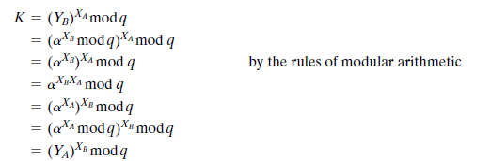
Diffie-Hellman Key Exchange
Shared session key for users A & B is:
session key for user A (K) =y_{B}^{xA} mod q (which A can compute)
session key for user B (K) =y_{A}^{xB} mod q (which B can compute)
Each principal has the other's public key and their own secret, along with α and q.
These two calculations produce identical results:
Notes:
7
The actual key exchange for either party consists of raising the others "public key' to power of their private key. The resulting number (or as much of as is necessary) is used as the key for a block cipher or other private key scheme. For an attacker to obtain the same value they need at least one of the secret numbers, which means solving a discrete log, which is computationally infeasible given large enough numbers. Note that if Alice and Bob subsequently communicate, they will have the same key as before, unless they choose new public-keys.

Slide 8
The result is that the two sides have exchanged a secret value.
Now consider an adversary who can observe the key exchange
and wishes to determine the secret key K.
Because X_{A} and X_{B} are private, an adversary only has the following Ingredients to work with: q, a, YA, and YB.
Thus, the adversary is forced to take a discrete logarithm to
determine the key.
For example, to determine the private key of user B, an adversary
must compute
XB = dlog_{a,q}(YB) (Because y_{B} = α ^{xB} mod q)

Slide 9
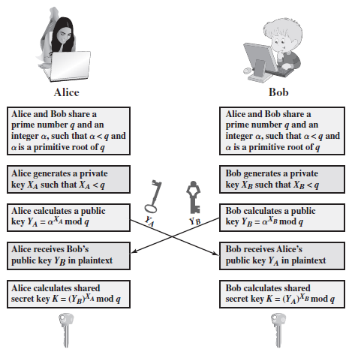
Diffie-Hellman Key Exchange (1)
Notes:
9
The actual key exchange for either party consists of raising the others "public key' to power of their private key. The resulting number (or as much of as is necessary) is used as the key for a block cipher or other private key scheme. For an attacker to obtain the same value they need at least one of the secret numbers, which means solving a discrete log, which is computationally infeasible given large enough numbers. Note that if Alice and Bob subsequently communicate, they will have the same key as before, unless they choose new public-keys.

Slide 10
Diffie-Hellman Key Exchange (2)
K_{AB} is used as session key (or pre-key) between Alice and Bob
If Alice and Bob subsequently communicate, they will have the same key as before, unless they choose new public-keys
Attacker needs a private key X, must solve discrete log base a modulo q to get it
Notes:
10
The actual key exchange for either party consists of raising the others "public key' to power of their private key. The resulting number (or as much of as is necessary) is used as the key for a block cipher or other private key scheme. For an attacker to obtain the same value they need at least one of the secret numbers, which means solving a discrete log, which is computationally infeasible given large enough numbers. Note that if Alice and Bob subsequently communicate, they will have the same key as before, unless they choose new public-keys.

Slide 11
Diffie-Hellman Example
Users Alice & Bob who wish to swap keys:
Agree on prime q = 353 and α = 3
Select random private keys:
Alice chooses X_{A}= 97, Bob chooses X_{B} = 233
Compute respective public keys:
Y_{A} = 3⁹⁷ mod 353 = 40 (Alice)
Y_{B} = 3²³³ mod 353 = 248 (Bob)
Compute shared session key as:
K = y_{B}^{xA} mod 353 = 248⁹⁷ mod 353 = 160 (Alice)
K = y_{A}^{xB} mod 353 = 40²³³ mod 353 = 160 (Bob)
Notes:
11
Here is an example of Diffie-Hellman from the text using prime q=353, showing how each computes its public key, and then how after they exchange public keys, each can compute the common secret key.I n this simple example, it would be possible by brute force to determine the secret key 160. In particular, an attacker E can determine the common key by discovering a solution to the equation 3ª mod 353 = 40 or the equation 3^{b} mod 353 = 248. The brute-force approach is to calculate powers of 3 modulo 353, stopping when the result equals either 40 or 248. The desired answer is reached with the exponent value of 97, which provides 3⁹⁷ mod 353 = 40. With larger numbers, the problem becomes impractical.

Slide 12
Key Exchange Protocols
Users could create random private/public D-H keys each time they communicate.
Users could create a known private/public D-H key and publish in a directory, then consult and use them to securely communicate with them.
Both of these are vulnerable to a Man-in-the-Middle Attack
Authentication of the keys is needed
Notes:
12
Now consider a simple protocol that makes use of the Diffie-Hellman calculation. Suppose that user A wishes to set up a connection with user B and use a secret key to encrypt messages on that connection. User A can generate a one-time private key X_{A}, calculate Y_{A}, and send that to user B. User B responds by generating a private value X_{B}, calculating Y_{B}, and sending Y_{B} to user A. Both users can now calculate the key. The necessary public values q and a would need to be known ahead of time. Alternatively, user A could pick values for q and a and include those in the first message.

Slide 13
Man-in-the-Middle Attack
Darth prepares by creating two private / public keys.
Alice transmits her public key to Bob.
Darth intercepts this and transmits his first public key to Bob. Darth also calculates a shared key with Alice.
Bob receives the public key and calculates the shared key (with Darth instead of Alice)
Bob transmits his public key to Alice.
Darth intercepts this and transmits his second public key to Alice. Darth calculates a shared key with Bob.
Alice receives the key and calculates the shared key (with Darth instead of Bob).
Darth can then intercept, decrypt, re-encrypt, forward all messages between Alice & Bob
Notes:
The protocol described on the previous slide is insecure against a man-in-the-middle attack. Suppose Alice and Bob wish to exchange keys, and Darth is the adversary. The attack proceeds as follows:
Darth prepares for the attack by generating two random private keys X_{D1} and X_{D2} and then computing the corresponding public keys Y_{D1} and Y_{D2}
Alice transmits Y_{A} to Bob.
Darth intercepts Y_{A} and transmits Y_{D1} to Bob. Darth also calculates K2 = (Y_{A} )^ X_{D2} mod q
Bob receives Y_{D1} and calculates K1=(Y_{D1} )^ X_{B} mod q
Bob transmits Y_{B} to Alice.
Darth intercepts Y_{B} and transmits Y_{D2} to Alice. Darth calculates K1=(Y_{B} )^ X_{D1} mod q
Alice receives Y_{D2} and calculates K2=(Y_{D2} )^ X_{A} mod q .
At this point, Bob and Alice think that they share a secret key, but instead Bob and Darth share secret key K1 and Alice and Darth share secret key K2. All future communication between Bob and Alice is compromised in the following way:
Alice sends an encrypted message M: E(K2, M).
Darth intercepts the encrypted message and decrypts it, to recover M.
Darth sends Bob E(K1, M) or E(K1, M'), where M' is any message. In the first case, Darth simply wants to eavesdrop on the communication without altering it. In the second case, Darth wants to modify the message going to Bob. The key exchange protocol is vulnerable to such an attack because it does not authenticate the participants. This vulnerability can be overcome with the use of digital signatures and public- key certificates.
13

Slide 14
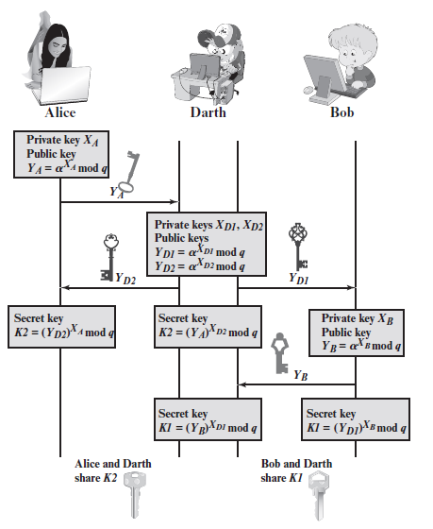
Man-in-the-Middle Attack

Slide 15
Man-in-the-Middle Attack
Also known as “Bucket Brigade” Attack
Need reliable way to associate public key with principal
Public key infrastructure (PKI) is one way
PGP web of trust is another
In some circumstances, may be possible to use scheduling/timing to prevent MITM
Notes:
The protocol described on the previous slide is insecure against a man-in-the-middle attack. Suppose Alice and Bob wish to exchange keys, and Darth is the adversary. The attack proceeds as follows:
Darth prepares for the attack by generating two random private keys X_{D1} and X_{D2} and then computing the corresponding public keys Y_{D1} and Y_{D2}
Alice transmits Y_{A} to Bob.
Darth intercepts Y_{A} and transmits Y_{D1} to Bob. Darth also calculates K2 = (Y_{A} )^ X_{D2} mod q
Bob receives Y_{D1} and calculates K1=(Y_{D1} )^ X_{B} mod q
Bob transmits Y_{B} to Alice.
Darth intercepts Y_{B} and transmits Y_{D2} to Alice. Darth calculates K1=(Y_{B} )^ X_{D1} mod q
Alice receives Y_{D2} and calculates K2=(Y_{D2} )^ X_{A} mod q .
At this point, Bob and Alice think that they share a secret key, but instead Bob and Darth share secret key K1 and Alice and Darth share secret key K2. All future communication between Bob and Alice is compromised in the following way:
Alice sends an encrypted message M: E(K2, M).
Darth intercepts the encrypted message and decrypts it, to recover M.
Darth sends Bob E(K1, M) or E(K1, M'), where M' is any message. In the first case, Darth simply wants to eavesdrop on the communication without altering it. In the second case, Darth wants to modify the message going to Bob. The key exchange protocol is vulnerable to such an attack because it does not authenticate the participants. This vulnerability can be overcome with the use of digital signatures and public- key certificates.
15

